Slide 1
Pipelining

Slide 2
Pipelining and vector processing are two methods of speeding up processing by performing multiple operations in parallel.
We perform more computations simultaneously in order to generate more results in less time.

Slide 3
A pipeline is very much like an assembly line.
Each stage in the pipeline performs its operation on data and passes the data to the next stage.
Each stage works on different data simultaneously.
Process data simultaneously in the different stages of the pipeline, results are generated more quickly.

Slide 4
Two types of Pipelines
  Arithmetic pipelines are used to speed up computations
  Instruction pipelines are used to speed up the fetch/decode/execute process.

Slide 5
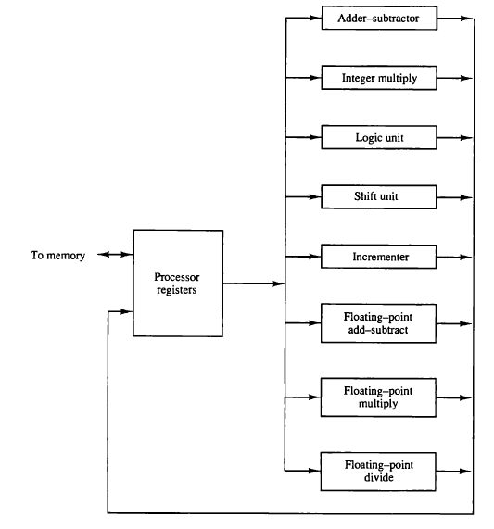
Parallel Processing Example
Multiple Functional Unit
  Separate the execution unit into eight functional units operating in parallel

Slide 6
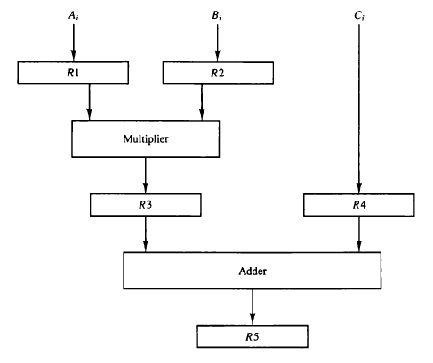


Slide 7
Computer Architectural Classification how they handle instructions and data
SISD (Single Instruction - Single Data stream)
  Computers read in a single instruction, decode and execute that instruction, and then go to the next instruction.
  Example systems : IBM 360/91
SIMD (Single Instruction - Multiple Data stream)
  computers are popular for operations which manipulate data by performing the same operation on all data.
  Applications which manipulate matrices, such as graphics rendering, perform fast Fourier transformations
  well suited for SIMD architectures.
MISD (Multiple Instruction - Single Data stream)
  computers are not used; this is included in the classification solely for completeness.
  Data Stream
MIMD (Multiple Instruction - Multiple Data stream)
  computers are classic supercomputers
  Multiprocessor

Slide 8
Pipelining
  Decomposing a sequential process into sub- operations
  Each sub-process is executed in a special dedicated segment concurrently

Slide 9
Arithmetic Pipeline
Usually found in very high speed computer
  Used to implement
    Floating point operations
    Multiplication
    Fixed point numbers
    Scientific Problems

Slide 10
Floating-point Adder Pipeline Example
    Add / Subtract two normalized floating-point binary number
      X = A x 2ª = 0.9504 x 10³
      Y = B x 2^{b} = 0.8200 x 10²
Sub-operations are performed in four segments
  Compare the exponents
  Align the mantissa
  Add or Subtract mantissa
  Normalize the result

Slide 11
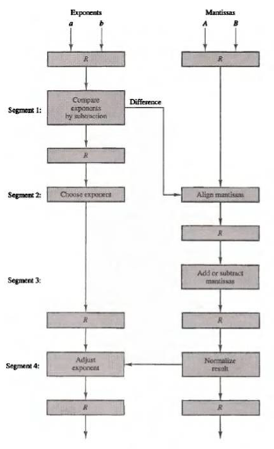

Slide 12
Instruction Pipeline
Instruction Cycle
  1) Fetch the instruction from memory
  2) Decode the instruction
  3) Calculate the effective address
  4) Fetch the operands from memory
  5) Execute the instruction
  6) Store the result in the proper place

Slide 13
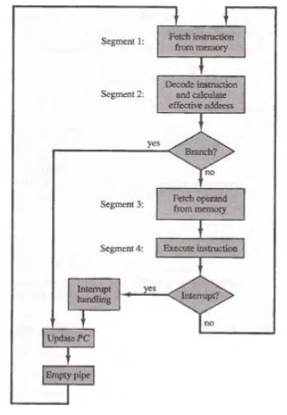

Slide 14
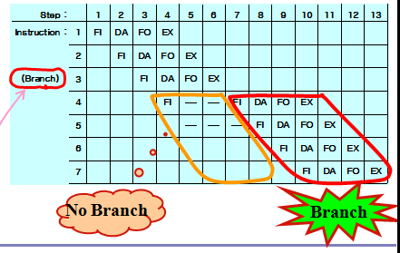
Example : Four-segment Instruction Pipeline
    Four-segment CPU pipeline
      1) FI : Instruction Fetch
      2) DA : Decode Instruction & calculate EA
      3) FO : Operand Fetch
      4) EX : Execution

Slide 15
Pipeline Conflicts : 3 major difficulties
Resource conflicts
  Memory access by two segments at the same time
Data dependency
  When an instruction depend on the result of a previous instruction, but this result is not yet available
Branch difficulties
  Branch and other instruction (interrupt, ret, ..) that change the value of PC
Data Dependency
  Hardware
      Hardware Interlock
        Hardware Delay
      Operand Forwarding
  Software
      Delayed Load
        previous instruction
        No-operation instruction
  Handling of Branch Instructions
    Prefetch target instruction
      Conditional branch
      branch target instruction

